Slide 1
Team 2
Dog Shop

Slide 2
Trương Tấn Phát: | Category, product, order, payment
Nguyễn Hoàng Gia Phúc: | User, cart, contact
Diệp Thái Thiên Long: | Discount, game, about

Slide 3
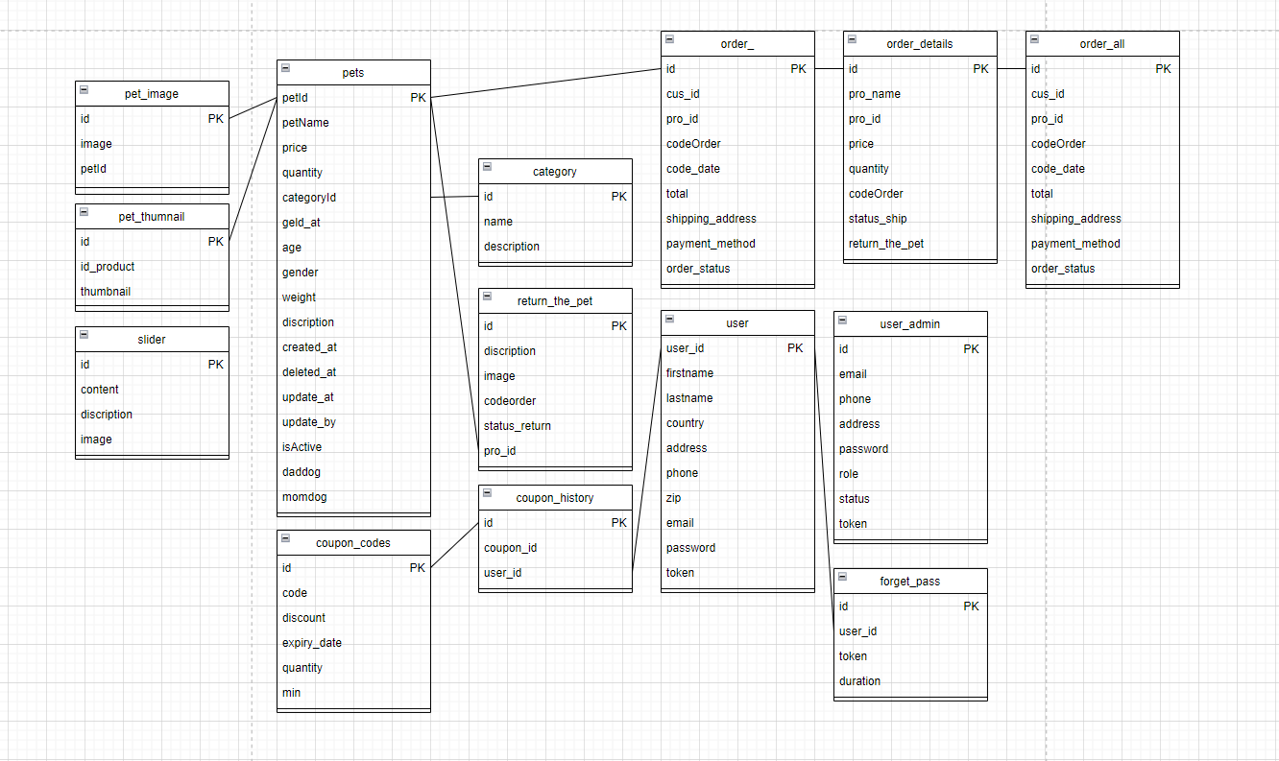

Slide 4
Frontend | HTML5, CSS, Jquery 3.4.1
 | Javascript 1.5
 | Bootstrap 5,html, css, ajax, google capcha
Backend | Call API PayPal, Google
 | QR Code
 | Php, mysql
SYSTEM REQUIREMENT SPECIFICATION
Processor | Intel Core i5 or higher.
Memory | 128 Megabytes of RAM or better.
Modem/ADSL | Connecting to internet 24/24
Processor | Intel Core i3 or higher.
Memory | 128 Megabytes of RAM or better.
Modem/ADSL | Connecting to internet
Operation System | Windows 7 or higher
Browser | Chrome version 35 or better
Database | MySQL
Software | IntelliJ IDEA
Operation System | Windows 7 or higher
Browser | Chrome version 35 or better
Database | MySQL
Software | IntelliJ IDEA

Slide 5
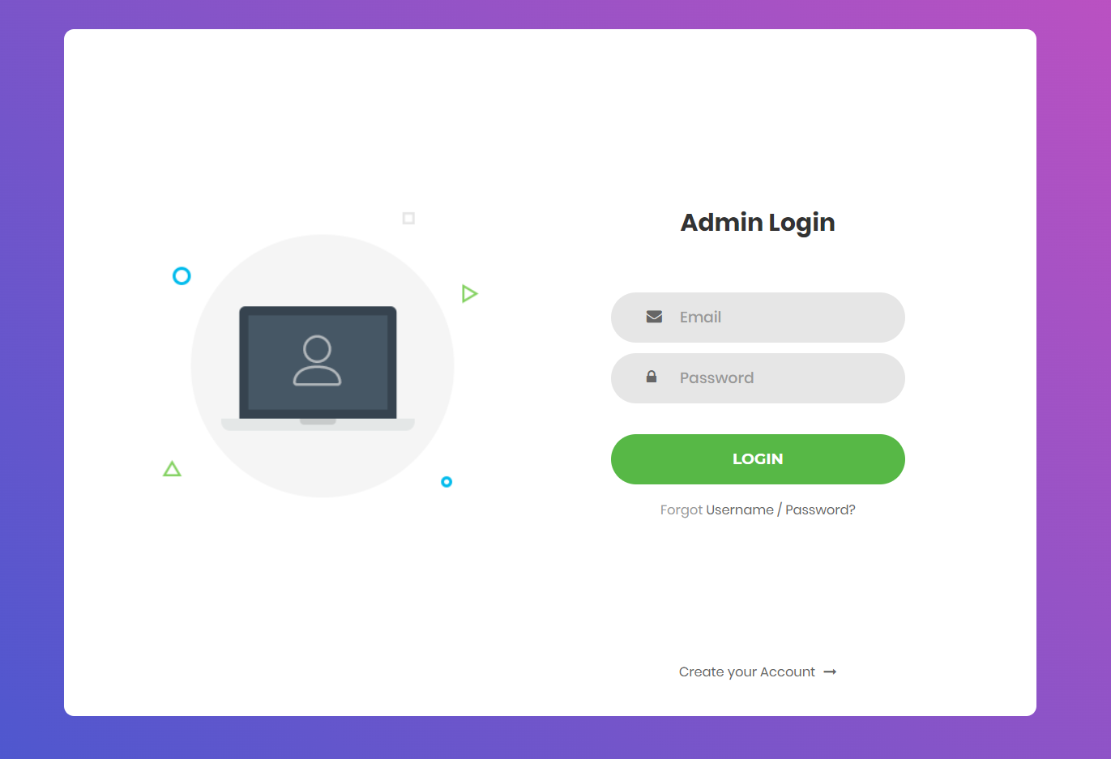
DESIGN
Admin
1. Login
1: email
2: password
3
2
1
No | Name | Type | Validation | Description | Status
1 | Email | Textbox | Input not blank | Enter Admin’s ID | Enable
2 | Password | Textbox | Input not blank | Enter Admin’s password | Enable
3 | SignIn | Button |  | Click to login | Enable

Slide 6
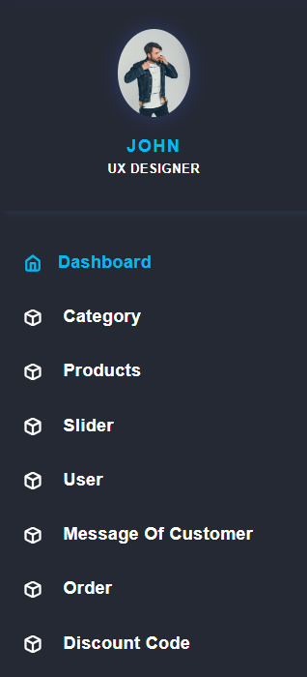
No | Name | Type | Validation | Description | Status
1 | dashboard | Link |  | Click on to go to Admin | Enable
2 | Categories | Link |  | Click on to go to Categories Product | Enable
3 | Manage Products | Link |  | Click on to go to Products Tab | Enable
4 | slider | Link |  | Click on to go to slider | Enable
5 | user | Link |  | Click on to go to Customer | Enable
6 | Message of customer | Link |  | Click on to go Message of customer | Enable
7 | Order | Link |  | Click on to go order | Enable
8 | Discount code | Link |  | Click on to go discount code | Enable

Slide 7
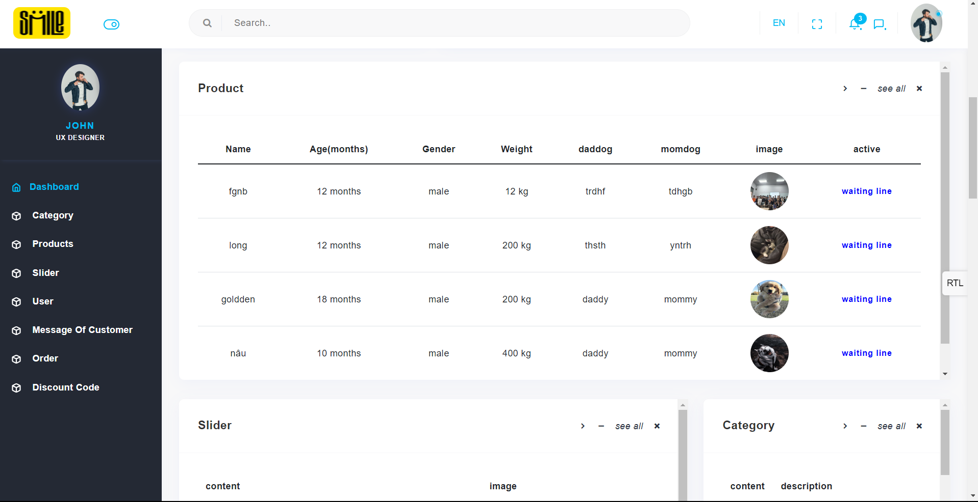

Slide 8
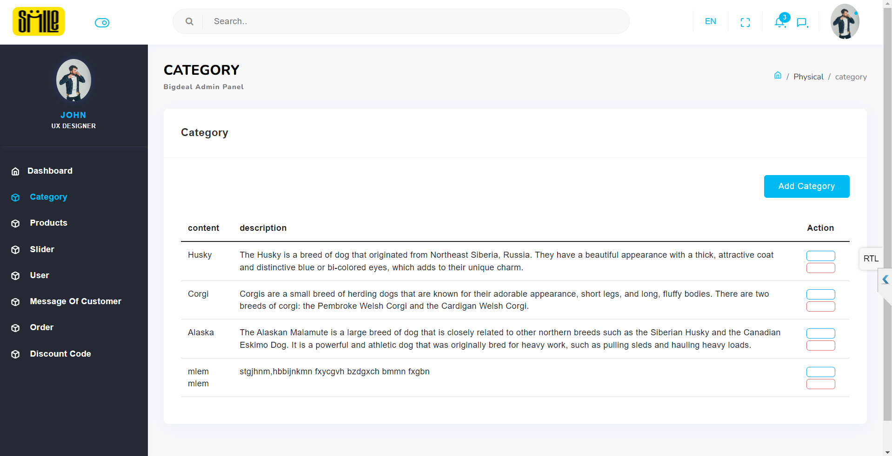

Slide 9
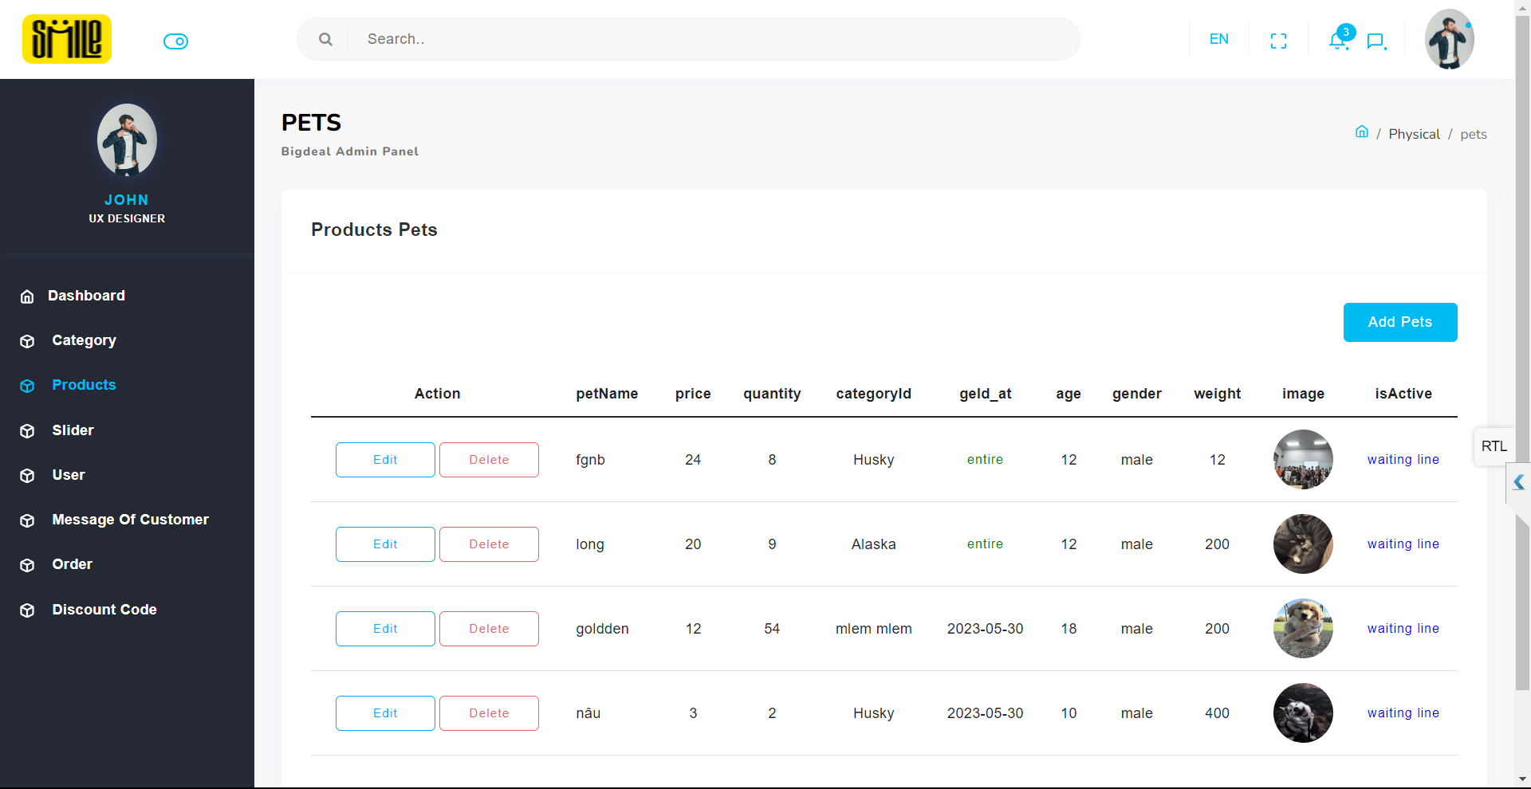

Slide 10
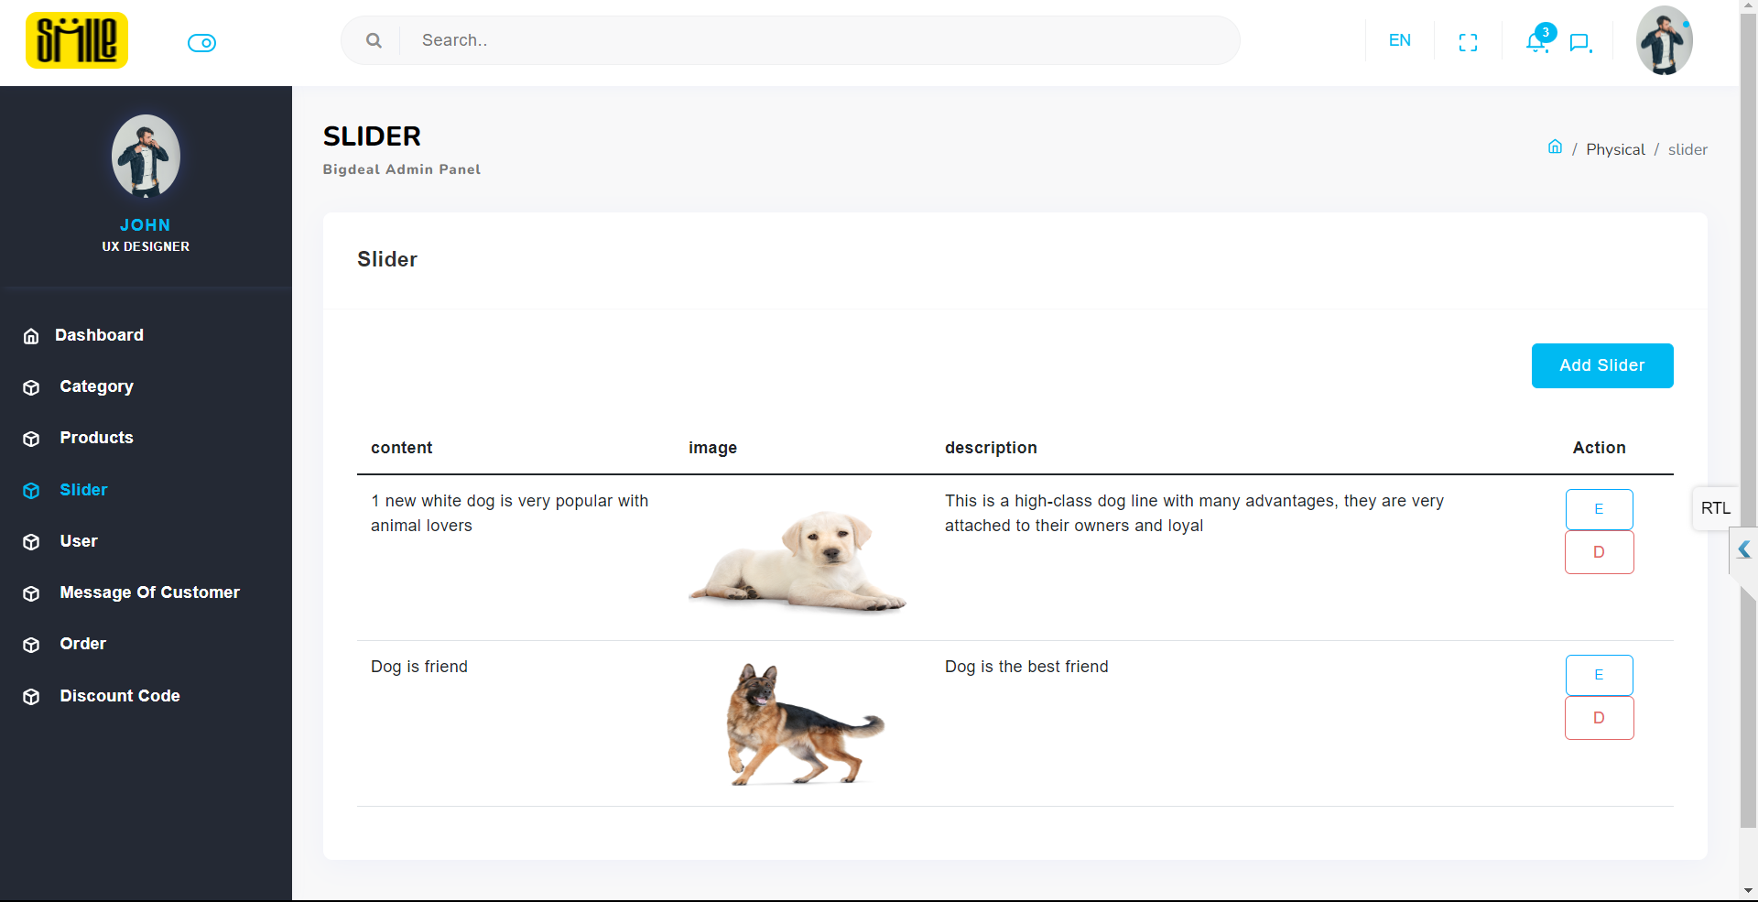

Slide 11
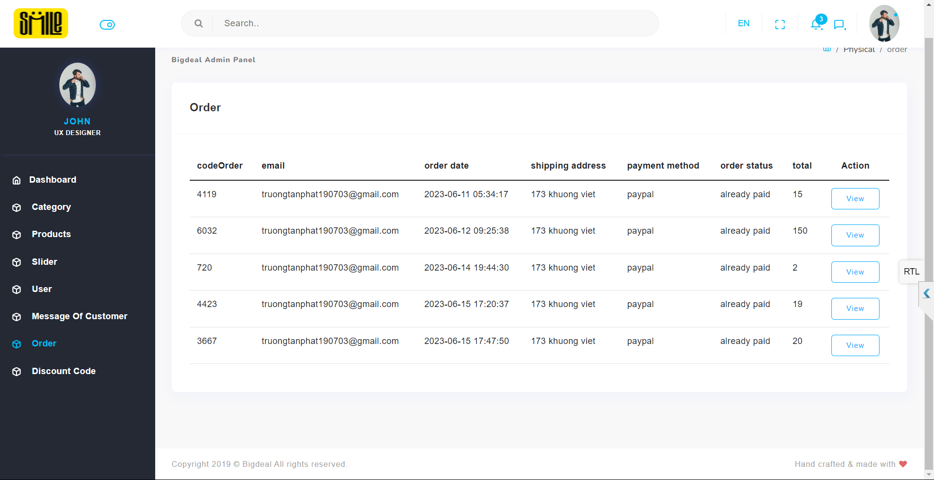

Slide 12
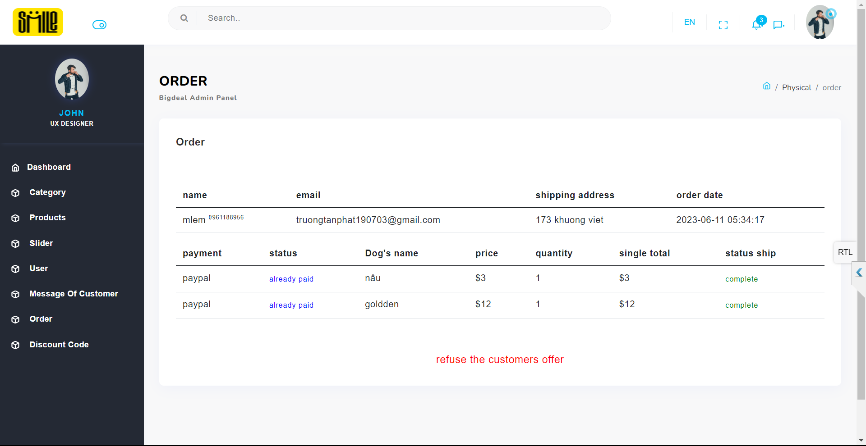

Slide 13
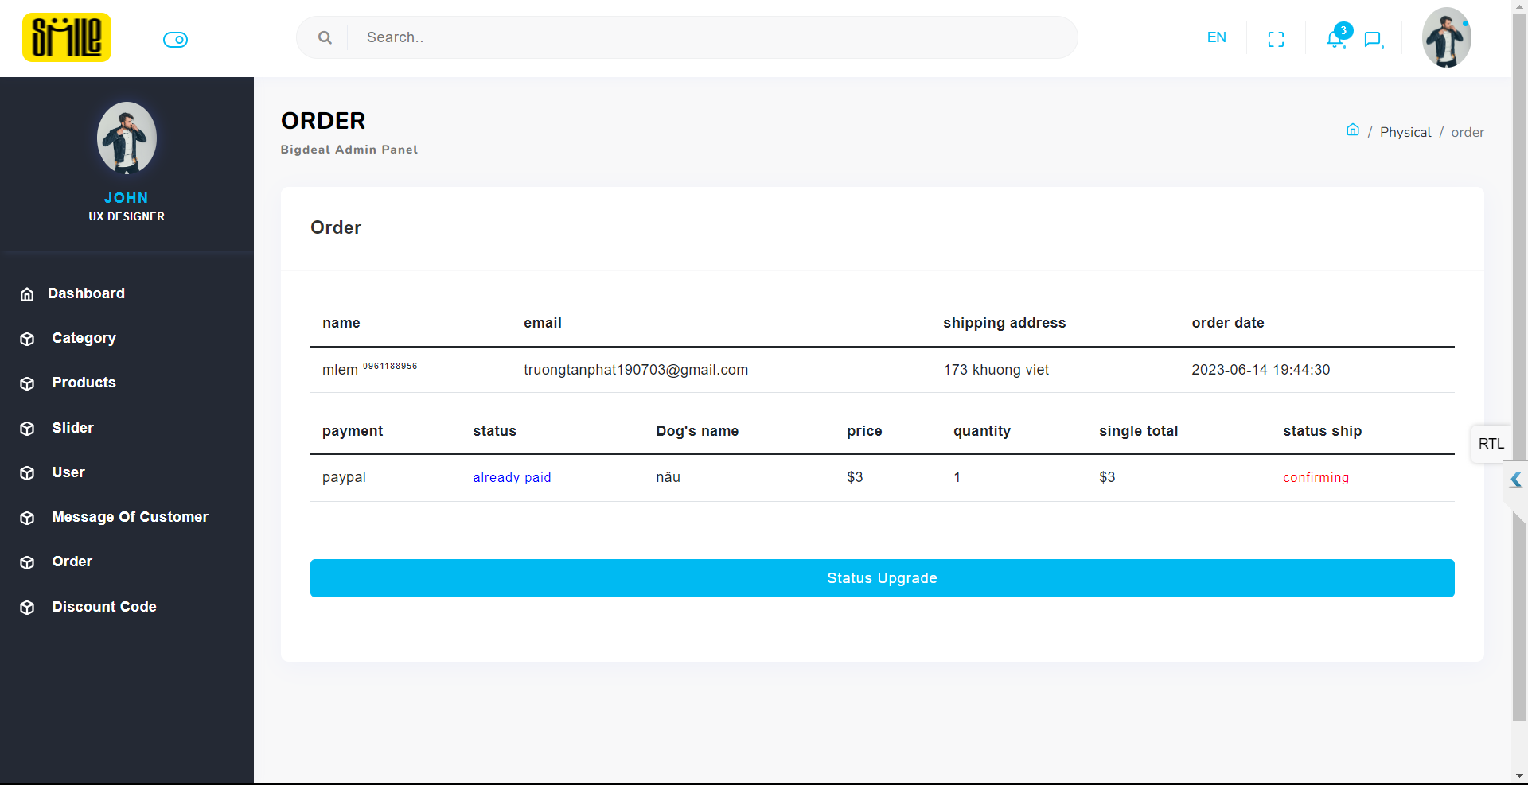

Slide 14
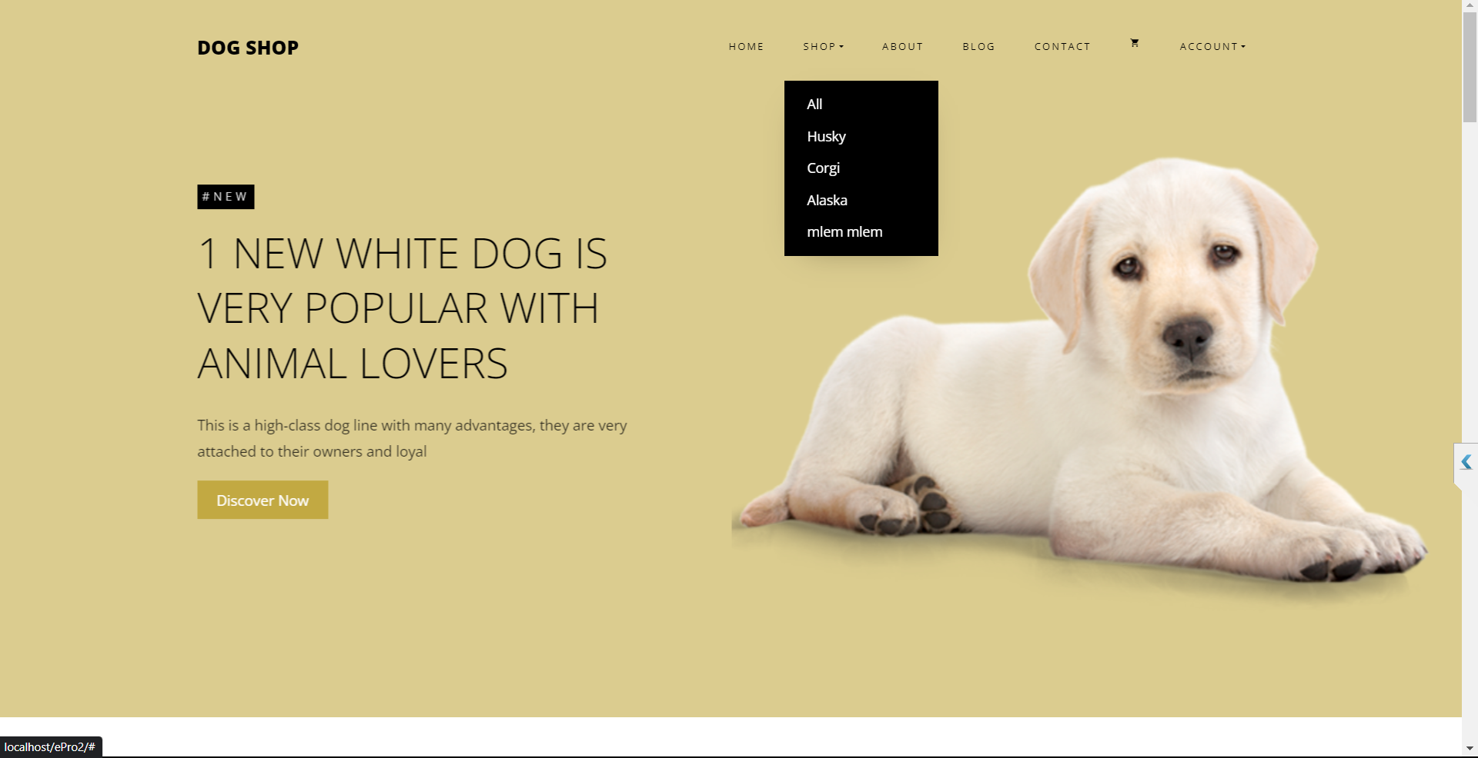

Slide 15
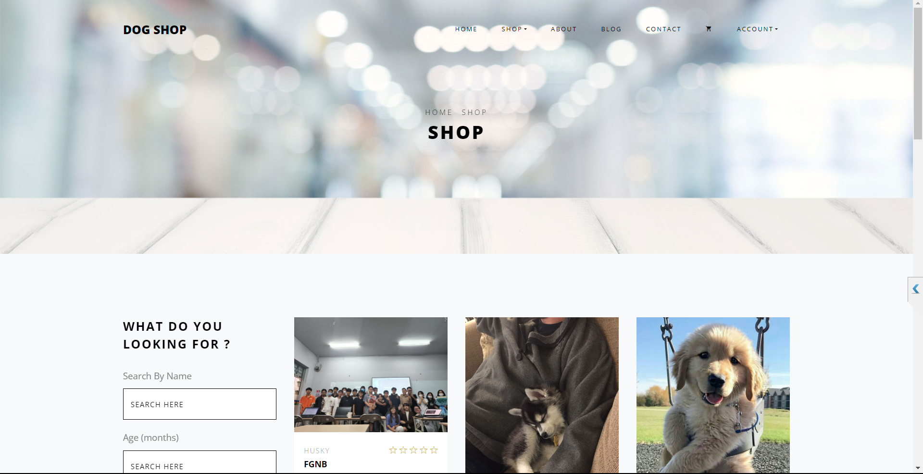

Slide 16
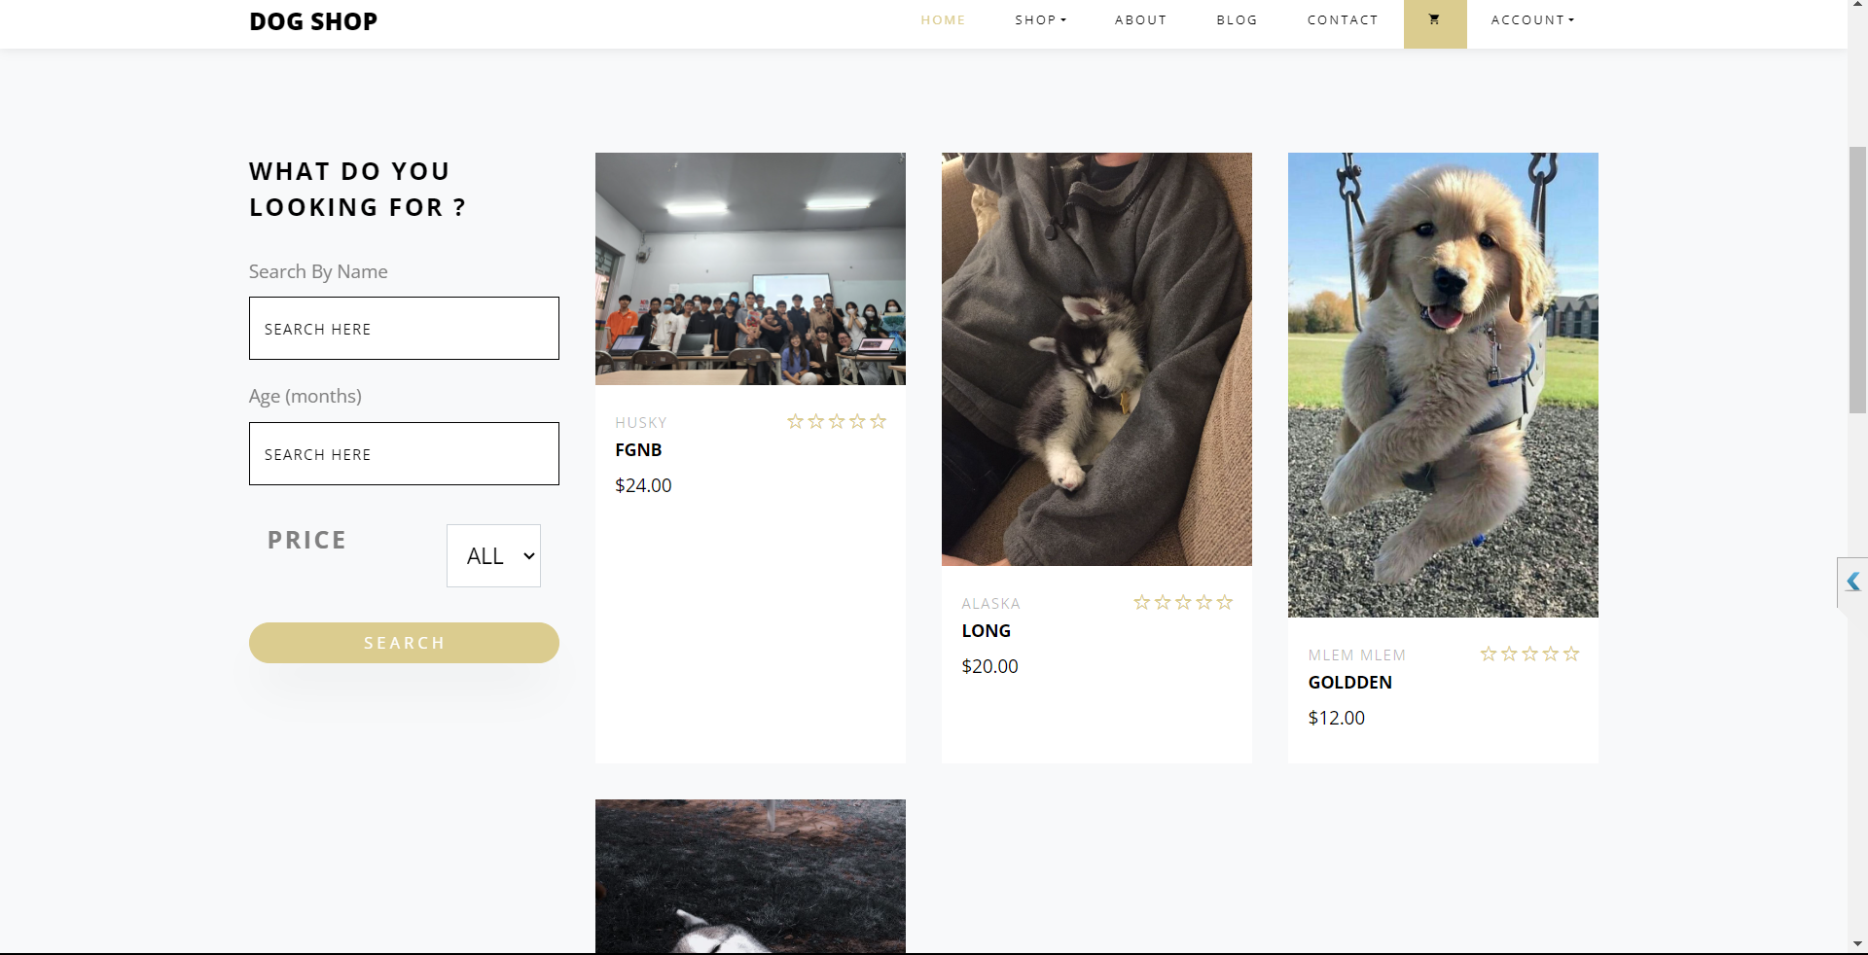

Slide 17
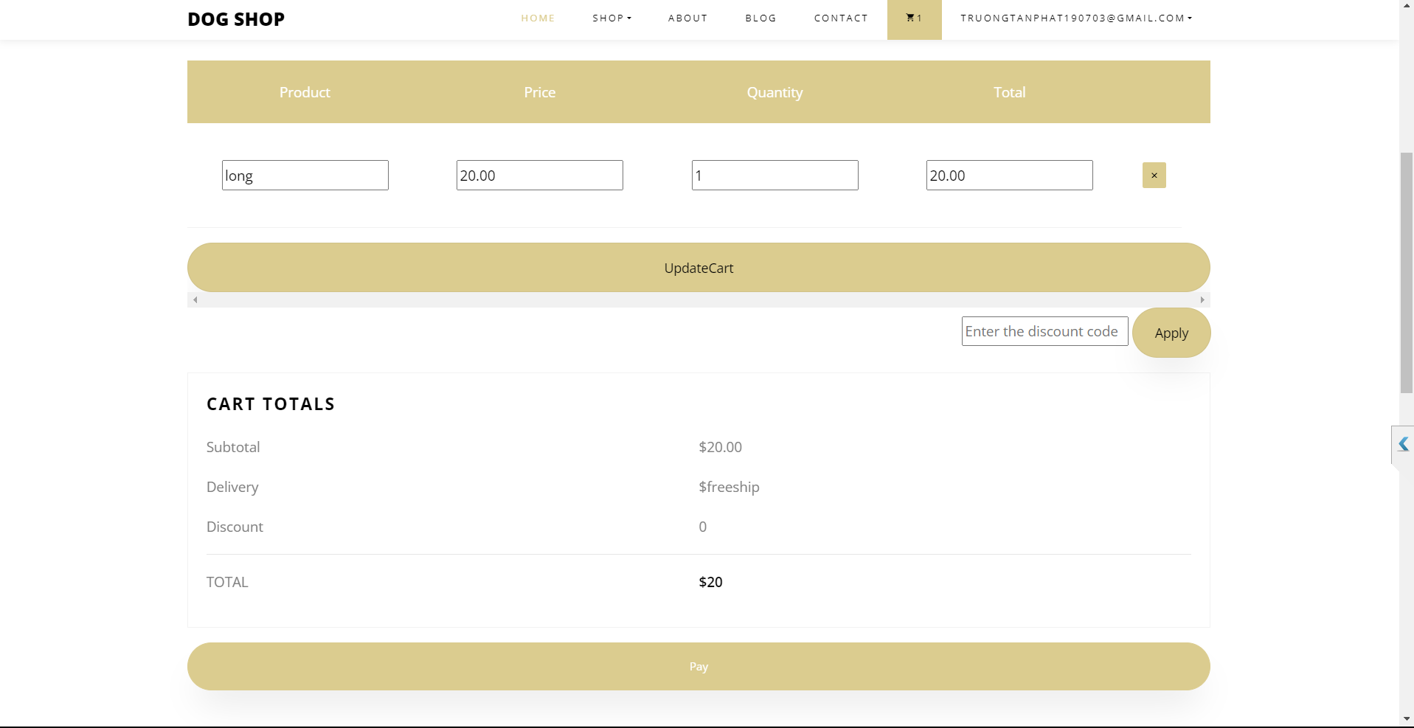

Slide 18
